Slide 1


Slide 2
SQL to NoSQL Database Migration
Bachelor Thesis
Klaidi Dingu

Slide 3
BASE Properties instead of ACID
Basically Available
Soft State
Eventually Consistent
BASE properties are adapted to give security and stability to data and application use when dealing with distributed systems.
Atomicity
Consistency
Isolation
Durability
ACID properties give SQL transactions the security that every modification of data will be fulfilled 100% and there will be no inconsistency in data after any update.

Slide 4

The new Database
MongoDB
Document Database

Slide 5
Migration Process

Slide 6
In NoSQL, models should be based on how the app interacts with the data rather than how the model can be stored as rows in one or more tables.
Main change is the data model

Slide 7
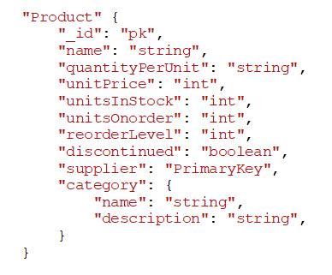
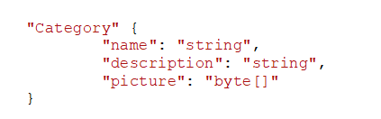
Sample of new model

Slide 8
How does the application use the database ?
The frequency at which the application makes calls to the database.
What type of calls are made to each table. (Writes / Reads)

Slide 9
Optimization Goals
Reduce calls the application needs to make to the database
Reduce network bandwidth usage for each call
Increase the speed of achieving each result

Slide 10
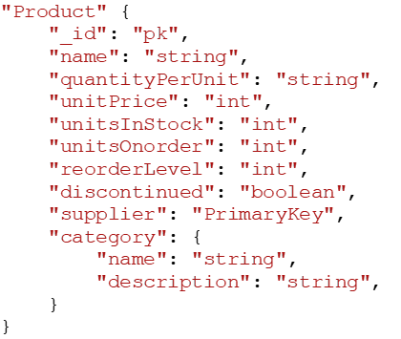

Optimization Goals

Slide 11
Migration Program

Slide 12
Program built in JAVA
Created classes to mimic the new model of data
Created a class that deals with the extraction, transformation and loading (simple ETL process) data into the new database

Slide 13
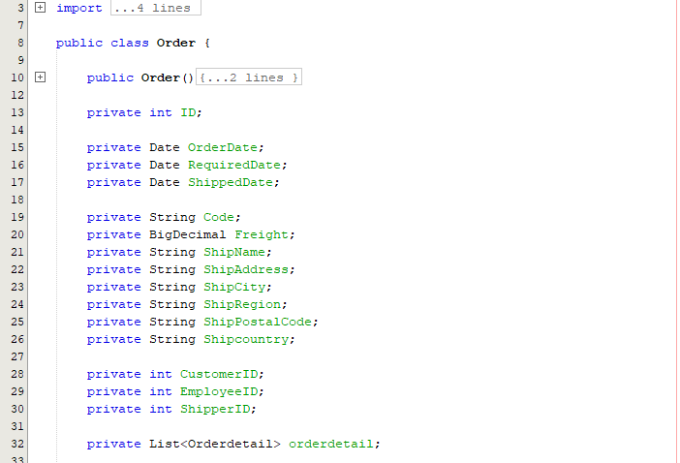
Class Order

Slide 14
Class Program
Connect to SQL Server
Extract Data and store into a Java Object
Add every object instance into a Java List
Close SQL Server connection
Use GSON API to create a JsonObject of each Java object stored in the List<ClassObject> and store these JsonObject into another List<JsonObject>
Parse each JsonObject into a Document object (org.bson.Document)
Connect to MongoDB
Load all documents into collection
Close connection
Exit

Slide 15
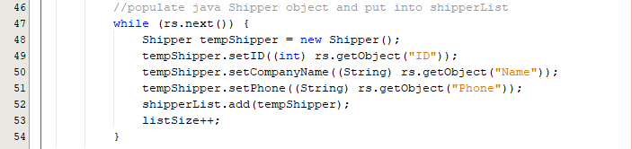
Class Program
This block of code stores extracted data into an instance of Shipper Java class

Slide 16
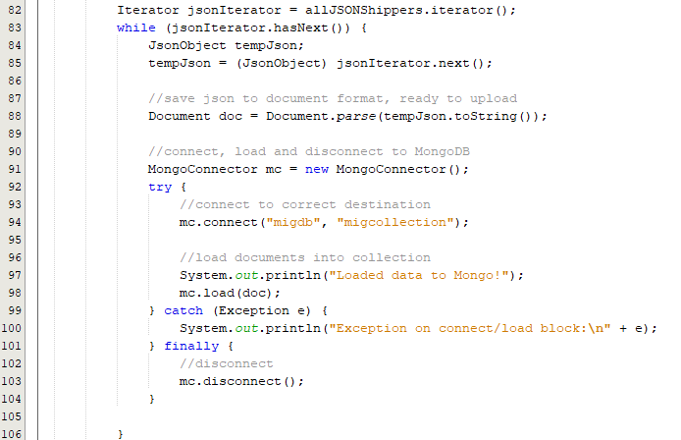
Class Program

Slide 17
Thank You !

